Slide 1
Web Development

Slide 2

Web Development Fundamentals
Building the Web with CSS, HTML & JavaScript
CSS HTML JavaScript
Notes:
Speaker Notes: Welcome everyone. Today we are demystifying how websites are built. By the end of this session, you will understand the three core languages of the web.

Slide 3
Agenda
What We Will Cover
How the Web Works
HTML: The Structure
CSS: The Style
JavaScript: The Interactivity
Putting It All Together
Tools & Next Steps
Notes:
Speaker Notes: We will move logically from skeleton to skin to muscle. We'll look at code examples for each and see how they combine.

Slide 4
How the Web Works
Client vs. Server
Browser (Client): Requests information (Chrome, Firefox).
Server: Stores and sends files.
The Code: HTML, CSS, and JS are sent to your browser to be rendered.
Notes:
Speaker Notes: You don't need to be a server expert yet. Just know that your code lives on a computer somewhere, and the browser downloads it to show the user.

Slide 5
HTML - The Structure
The House Analogy
🏗️ HTML: The Framework (Walls, Beams)
🎨 CSS: The Decoration (Paint, Carpet)
⚡ JavaScript: The Functionality (Electricity, Garage Door)
Notes:
Speaker Notes: This is the most important analogy. HTML is useless without structure, ugly without CSS, and static without JS.

Slide 6
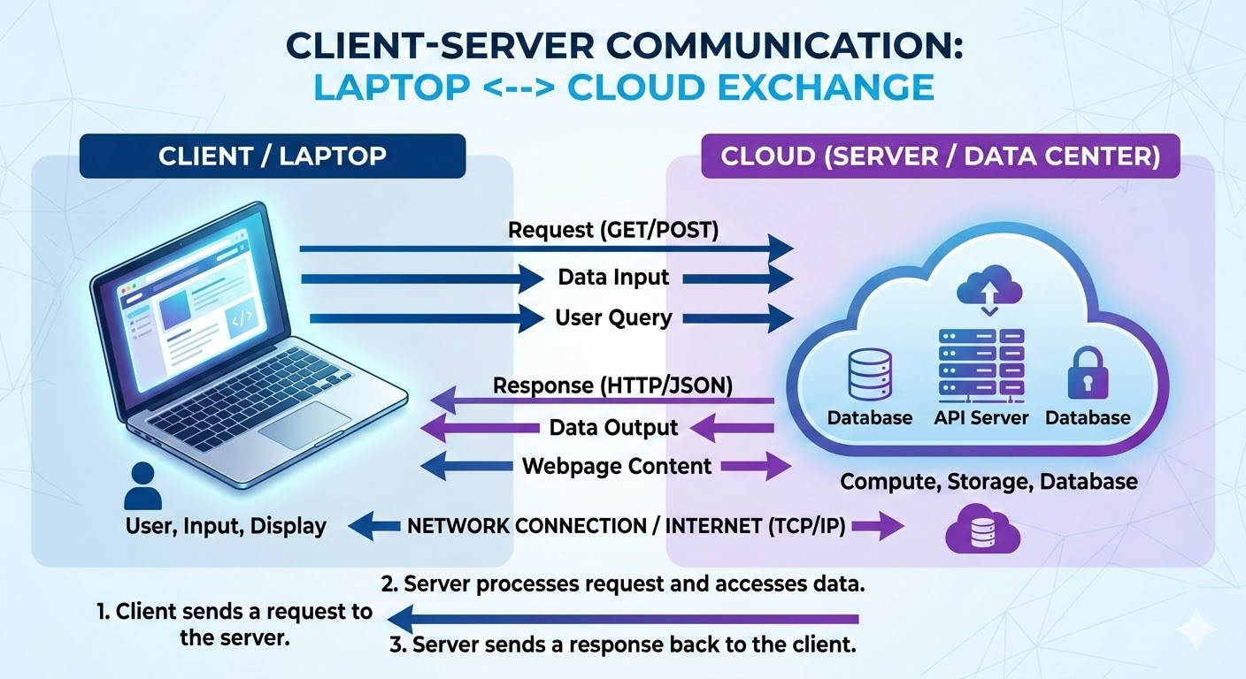
HTML - The Structure
Notes:
Speaker Notes: This is the most important analogy. HTML is useless without structure, ugly without CSS, and static without JS.

Slide 7
HTML Basics
What is HTML?
HyperText Markup Language.
Uses Tags to define elements.
Tags usually come in pairs: <opening> and </closing>.
<p>This is a paragraph.</p>
<h1>This is a Heading</h1>
Notes:
Speaker Notes: Think of tags as containers. You put content inside the opening and closing tag to tell the browser what that content is.

Slide 8
Common HTML Tags
<h1> to <h6>: Headings
<p>: Paragraphs
<a href="...">: Links
<img src="...">: Images (Self-closing)
<button>: Clickable buttons
Notes:
Speaker Notes: These are the Lego bricks you will use 90% of the time. Note that images don't have a closing tag because they don't hold text inside them.

Slide 9
The HTML Skeleton
Standard Document Structure
<!DOCTYPE html>
<html>
<head>
<title>My Page</title>
</head>
<body>
<!-- Content goes here -->
</body>
</html>
<head>: Meta info (not visible).
<body>: Visible content.
Notes:
Speaker Notes: Every HTML file needs this boilerplate. The head is for the browser's eyes; the body is for the user's eyes.

Slide 10
HTML Demo
Let's Build Structure
<h1>Welcome!</h1>
<p>Learn to code today.</p>
<button>Sign Up</button>
Notes:
Visual: Split screen. Left side: Code. Right side: Browser Render.
Speaker Notes: (Live Demo Idea) If possible, switch to a code editor here and type this out to show how saving the file updates the browser.

Slide 11
Intro to CSS
Cascading Style Sheets
Controls layout, colors, fonts, and spacing.
Separates content (HTML) from design (CSS).
Makes sites responsive (mobile-friendly).
Notes:
Visual: Before (Plain HTML) vs. After (Styled CSS) screenshot.
Speaker Notes: Without CSS, the web would look like a Word document from 1995. CSS makes it beautiful.

Slide 12
CSS Syntax
How to Write CSS
selector {
property: value;
}
Example
h1 {
color: blue;
font-size: 20px;
}
Notes:
Speaker Notes: You select what you want to style, open the curly braces, and declare how you want it to look.

Slide 13
Selectors
Targeting Elements
Element: p { } (All paragraphs)
Class: .btn { } (Reusable, multiple elements)
ID: #header { } (Unique, one per page)
<p class="text">Hello</p>
<div id="main">Content</div>
Notes:
Speaker Notes: Classes are your best friend. Use them for groups of items. Use IDs for specific sections like a navigation bar.

Slide 14
The Box Model
Everything is a Box
Content: The text/image.
Padding: Space inside the border.
Border: The line around the padding.
Margin: Space outside the border.
Notes:
Visual: Diagram of the Box Model (Content -> Padding -> Border -> Margin).
Speaker Notes: This is the #1 concept beginners struggle with. If things aren't spacing correctly, it's usually a Margin or Padding issue.

Slide 15
CSS Demo
Styling the Page
button {
background: green;
color: white;
padding: 10px 20px;
border: none;
}
Notes:
Visual: Split screen. Code on left, Result on right.
Speaker Notes: Notice how the button changes from a grey default to a branded green button just with a few lines of code.

Slide 16
JavaScript - The Logic
Making it Interactive
A programming language.
Runs in the browser.
Handles logic, data, and user events.
Examples:
Form validation.
Image sliders.
Fetching data (like tweets or weather).
Notes:
Speaker Notes: HTML/CSS are static. JS is dynamic. It allows the page to change after it has loaded.

Slide 17
Variables & Data
Storing Information
Variables: Containers for data.
Keywords: let, var and const
Types: Strings (text), Numbers, Booleans (true/false).
let userName = "Alice";
let age = 25;
let isLoggedIn = true;
Notes:
Speaker Notes: let creates a variable. We use quotes for text and no quotes for numbers.

Slide 18
Functions
Reusable Actions
A block of code designed to perform a task.
Can be "called" (run) whenever needed.
function sayHello() {
alert("Hello World!");
}
Notes:
Speaker Notes: Instead of writing the same code twice, write a function once and run it whenever you need it.

Slide 19
The DOM
Document Object Model
JS connects to HTML via the DOM.
JS can find elements.
JS can change elements.
document.querySelector("h1").innerText = "New Title!";
Notes:
Speaker Notes: The DOM is the bridge. It allows JavaScript to reach into your HTML and swap out text, colors, or images.

Slide 20
Events
Listening to the User
JS waits for things to happen.
Click, Scroll, Submit, Load.
button.addEventListener("click", sayHello);
Notes:
Speaker Notes: This is how we make buttons work. We tell the button: "When clicked, run the sayHello function."

Slide 21
Tools of the Trade
Where to Code?
Editor: VS Code (Recommended), Sublime Text.
Browser: Chrome or Firefox (Use Developer Tools!).
Practice: CodePen, JSFiddle (for quick tests).
Notes:
Visual: Logos of VS Code and Chrome DevTools.
Speaker Notes: Download VS Code. Learn to right-click and "Inspect" on any website to see their HTML/CSS. It's the best way to learn.

Slide 22
Next Steps & Resources
Keep Building!
Practice: Build a personal portfolio.
Docs: MDN Web Docs (The Bible of Web Dev).
Courses: freeCodeCamp, The Odin Project.
Q&A
Notes:
Speaker Notes: You can't learn this just by watching. You must type the code. Start small, break things, and fix them. Thank you!

